Slide 1
United International University
PHY 2105
Mechanics, Waves and Oscillation, Physical Optics

Slide 2
Part 1I
Simple harmonic oscillators
Damped oscillators
Driven oscillators
Resonance
The Wave Equation

Slide 3
Part III
Theories of Light
Interference of Light
Diffraction of Light
Polarization of Light
Disparsion of Light

Slide 4
Part I
Vectors and Vector Algebra
Motion in One-dimension and Two-dimensions
Newton’s Laws of Motion
Work, Energy and Momentum
Rotational dynamics
Fluid dynamics and applications

Slide 5
What to do in this course:
Read the relevant sections in the textbook … the course notes will guide you.
2. Do all homework and problem sets.
3. Get help early … from Course Teacher.
4. there are no shortcuts … put effort in to understand things …

Slide 6
Problem-solving and homework
Each Chapter you will be given a take-home problem set to complete and hand in for marks ... In addition to this, you need to work through the problems in Book, in you own time, at home.
You will not be asked to hand these in for marks. Get help from you friends, the course Teacher ...
Do not take shortcuts. Mastering these problems is a fundamental aspect of this course.

Slide 7

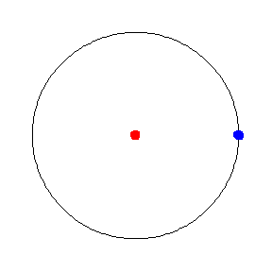
Different Kind of Motions
Linear Motion
Uniform Circular Motion

Slide 8
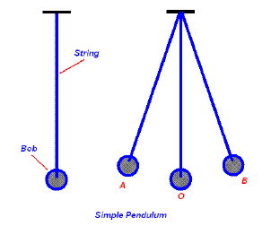
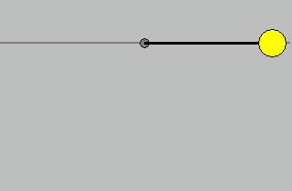
Oscillatory Motion (Simple Pendulum)

Slide 9
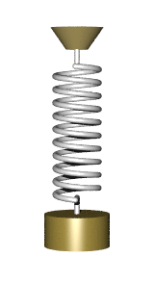
Oscillatory Motion (Spring Mass)

Slide 10
Oscillatory Phenomena
… observed in many physical systems …
from the very small…(e.g. dipole resonance in nuclei)… to the very large (earthquake waves, stars,…)
Mechanical systems …… to lasers
…… from violin strings …… to electrical systems

Slide 11
Oscillatory Motion
Motion which is periodic in time, that is, motion that repeats itself in time.
Examples:
Power line oscillates when the wind blows past it
Earthquake oscillations move buildings

Slide 12
Block attached to a spring
Motion of a swing
Motion of a pendulum
Vibrations of a stringed musical instrument
Motion of a cantilever
Oscillations of houses, bridges, …
All clocks use simple harmonic motion

Slide 13
Periodic Motion: Many kind of motion repeat over and over, such as, the vibrations of quartz crystal in a watch, swinging pendulum in a clock and back-and-forth motion of a piston in an engine. This kind of motions are called periodic motion.

Slide 14
Amplitude: The amplitude of the motion, denoted by A, is the maximum magnitude of displacement from the equilibrium position. It is always positive
Time Period: The period T, is the time required for one oscillation.
Frequency: The frequency, f, is the number of complete oscillations in a unit time.

Slide 15
Simple Harmonic Motion: The simplest kind of oscillation occurs when the restoring force F_{x} is directly proportional to the displacement from the equilibrium x.
When the restoring force is directly proportional to the displacement from the equilibrium as given by equation
The oscillation is called Simple Harmonic Motion(SHM).

Slide 16
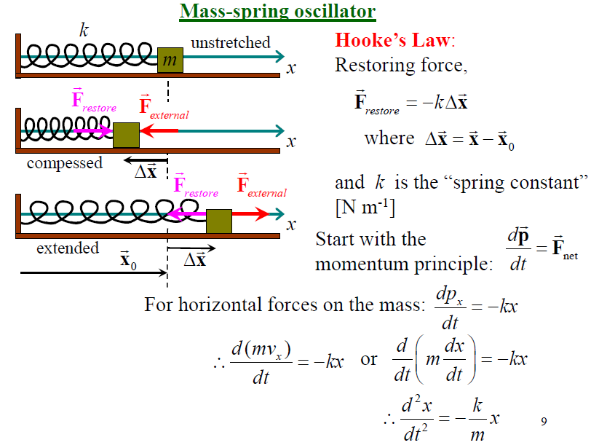

Slide 17
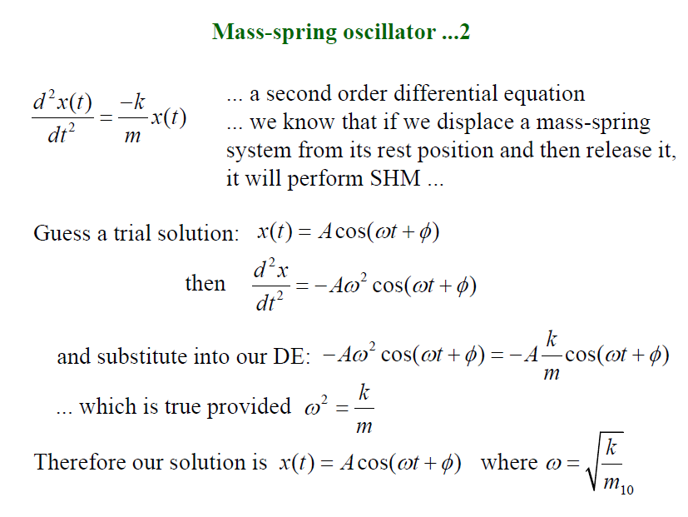

Slide 18
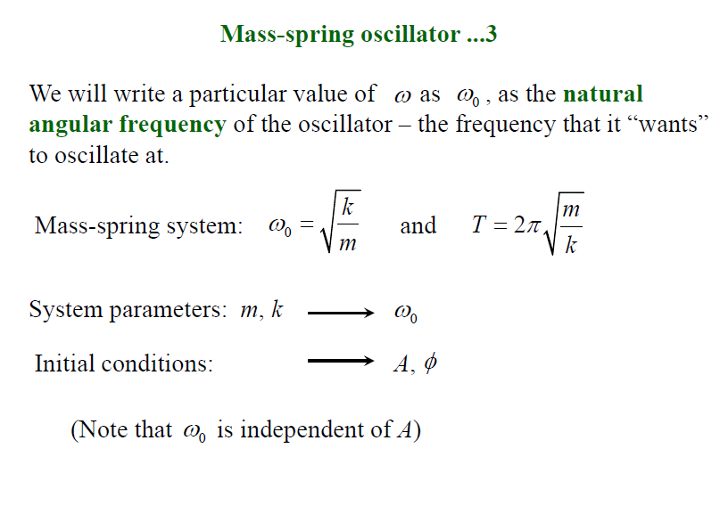

Slide 19
What is ω?
Let us now find the physical significance of constant ω. If the
time t in displacement equation is increased by 2π/ω,
the function becomes
The function merely repeat itself after a time 2π/ω. Therefore
2π/ω is period of the motion.

Slide 20
We have
We have got
Therefore,
The quantity ω is called angular
Frequency.

Slide 21
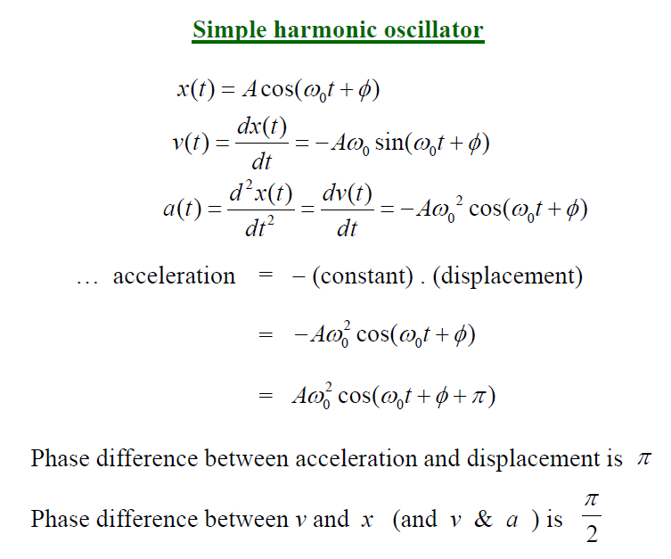

Slide 22
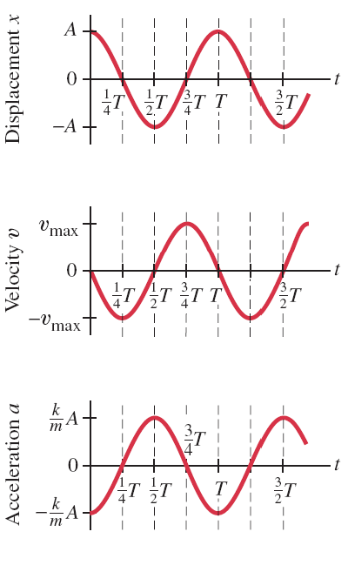
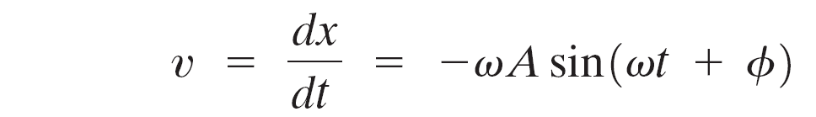
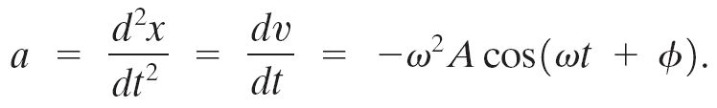
The velocity and acceleration for simple harmonic motion can be found by differentiating the displacement:
Notes:
Figure 14-8. Caption: Displacement, x, velocity, dx/dt, and acceleration, d²x/dt², of a simple harmonic oscillator when φ = 0.

Slide 23
Notes:
Figure 14-8. Caption: Displacement, x, velocity, dx/dt, and acceleration, d²x/dt², of a simple harmonic oscillator when φ = 0.

Slide 24
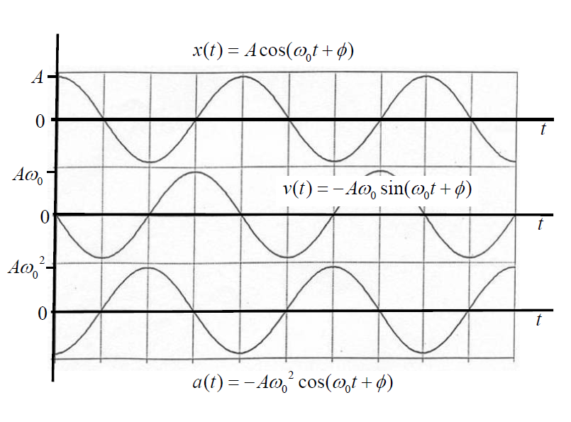

Slide 25
Phase Difference
The phase of periodic wave describes where the wave is in its cycle
Phase difference is used to describe the phase position of one wave relative to another

Slide 26
Phase Difference 180°
τ
pressure
time
½ τ

Slide 27
Phase Difference 90°
pressure
time
¼τ

Slide 28
Phase Difference 45°
pressure
time
1/8 τ
Wave A
Wave B

Slide 29
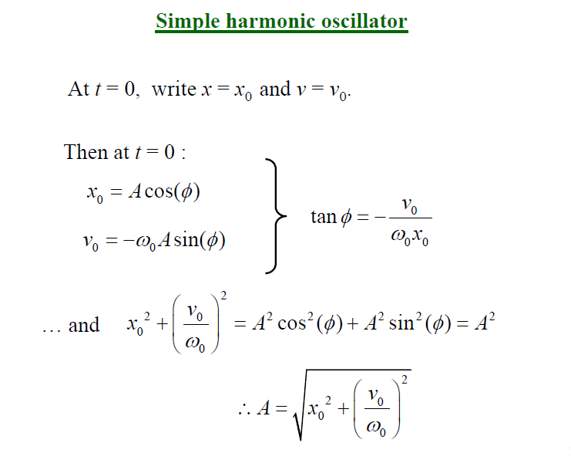

Slide 30
Ex. A block of mass 680gm is fastened to a spring of
spring constant 65N/m. The block is pulled a distance
11cm from its equlibrum on a frictionless table and
released
What are the angular frequency, the frequency, and
the period of the motion?
(b) What is amplitude of the motion?
(c) What is the maximum speed of the block?

Slide 31
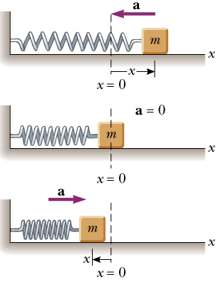
Example
A spring stretches by 3.90 cm when a 10.0 g mass is hung from it. A 25.0 g mass attached to this spring oscillates in simple harmonic motion.
Calculate the period of the motion.
Calculate frequency and the angular velocity of the motion.

Slide 32
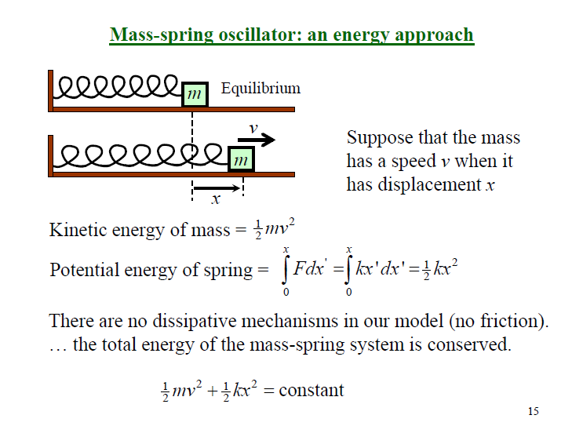

Slide 33
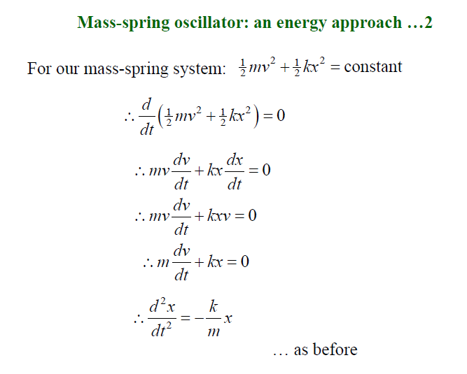

Slide 34
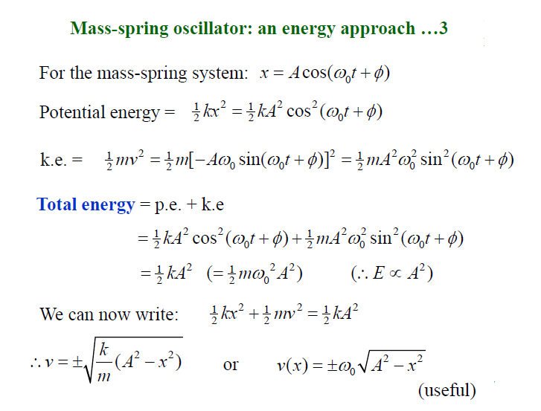

Slide 35
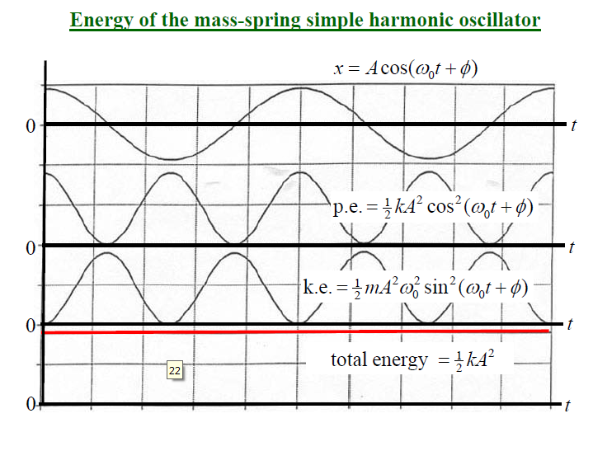

Slide 36
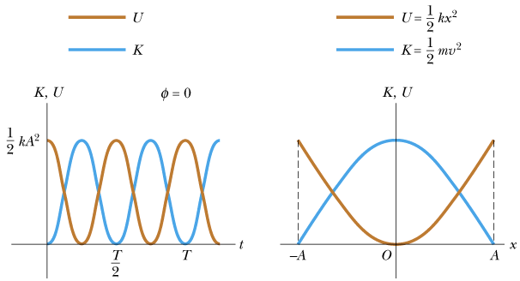
K.E and P.E of SHM

Slide 37
Check Your Understanding
A 0.42-kg block is attached to the end of a horizontal ideal spring and rests on a frictionless surface. The block is pulled so that the spring stretches by 2.1 cm relative to its unstrained length. When the block is released, it moves with an acceleration of 9.0 m/s². What is the spring constant of the spring?
180 N/m

Slide 38
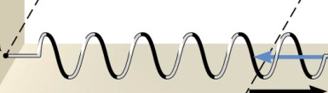
2.1cm
kx = ma

Slide 39
Energy in the SHO
Energy calculations.
For the simple harmonic oscillation where k = 19.6 N/m, A = 0.100 m, x = -(0.100 m) cos 8.08t, and v = (0.808 m/s) sin 8.08t, determine (a) the total energy, (b) the kinetic and potential energies as a function of time, (c) the velocity when the mass is 0.050 m from equilibrium, (d) the kinetic and potential energies at half amplitude (x = ± A/2).
Notes:
Solution: a. E = ½ kA² = 9.80 x 10⁻² J.
b. U = ½ kx² = (9.80 x 10⁻² J) cos² 8.08t, K = ½ mv² = (9.80 x 10⁻² J) sin² 8.08t.
c. v = 0.70 m/s
d. U = 2.5 x 10⁻² J, K = E – U = 7.3 x 10⁻² J.

Slide 40
Solution:

Slide 41
Solution:

Slide 42
Example: Using Conservation of Energy
A 500 g block on a spring is pulled a distance of 20 cm and released. The subsequent oscillations are measured to have a period of 0.80 s. At what position (or positions) is the speed of the block 1.0 m/s?

Slide 43
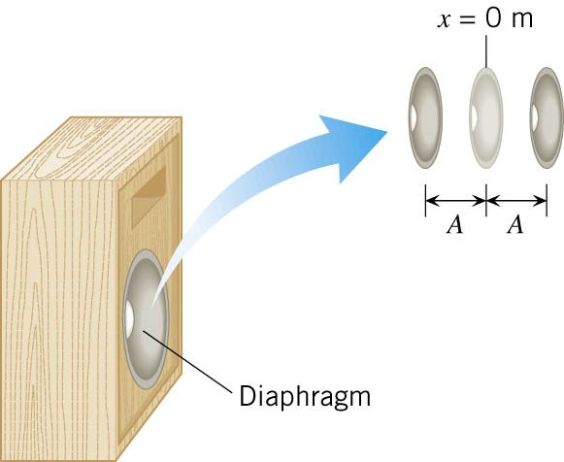
Example: The Maximum Speed of a Loudspeaker Diaphragm
The diaphragm of a loudspeaker moves back and forth in simple harmonic motion to create sound. The frequency of the motion is f = 1.0 kHz and the amplitude is A = 0.20 mm.
What is the maximum speed of the diaphragm?
Where in the motion does this maximum speed occur?

Slide 44
(a)
(b) The speed of the diaphragm is zero when the diaphragm momentarily comes to rest at either end of its motion: x = +A and x = –A. Its maximum speed occurs midway between these two positions, or at x = 0 m.

Slide 45
Example: Radio Station Frequency and Period
What is the oscillation period of an FM radio station that broadcasts at 100 MHz?
Note that 1/Hz = s

Slide 46
Example : The Loudspeaker Revisited—The Maximum Acceleration
A loudspeaker diaphragm is vibrating at a frequency of f = 1.0 kHz, and the amplitude of the motion is A = 0.20 mm.
What is the maximum acceleration of the diaphragm, and
where does this maximum acceleration occur?

Slide 47
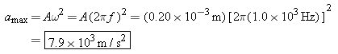
(a)
(b) the maximum acceleration occurs at x = +A and x = –A

Slide 48
Check Your Understanding
The drawing shows plots of the displacement x versus the time t for three objects undergoing simple harmonic motion. Which object, I, II, or III, has the greatest maximum velocity?
II

Slide 49
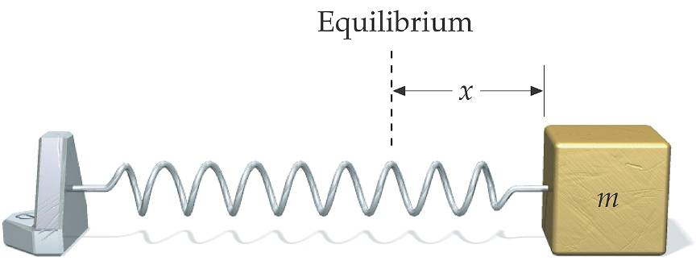
Example: A Block on a Spring
A 2.00 kg block is attached to a spring as shown. The force constant of the spring is k = 196 N/m. The block is held a distance of 5.00 cm from equilibrium and released at t = 0.
(a) Find the angular frequency ω, the frequency f, and the period T. (b) Write an equation for x vs. time.

Slide 51
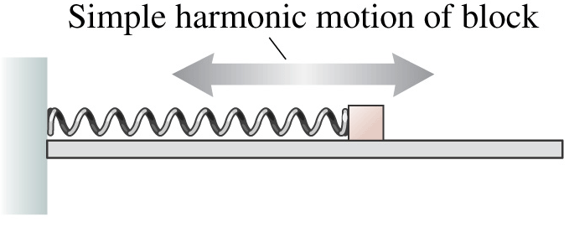
Example: A System in SHM
An air-track glider is attached to a spring, pulled 20 cm to the right, and released at t-=0. It makes 15 complete oscillations in 10 s.
What is the period of oscillation?
What is the object’s maximum speed?
What is its position and velocity at t=0.80 s?

Slide 53
Example: Finding the Time
A mass, oscillating in simple harmonic motion, starts at x = A and has period T.
At what time, as a fraction of T, does the mass first pass through x = ½A?

Slide 54
Ex. A particle execute s simple harmonic motion given
by the equation
Calculate (i) amplitude, (ii) frequency, (iii) displacement
at t= 1.25s, (iv) velocity at t= 2.5s (v) acceleration at
t= 5s.

Slide 55
Ex. A particle execute s simple harmonic motion given by the equation
Calculate (i) frequency, (ii) time period (iii) the
maximum displacement (iv)the maximum velocity
(v) the maximum acceleration acceleration.

Slide 56
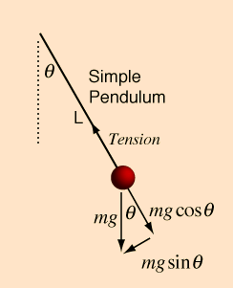
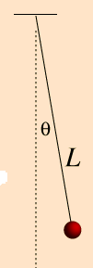
Simple Pendulum
A simple pendulum consists of a particle of mass m, attached to a frictionless point by a cable of length L and negligible mass.

Slide 57
From the above figure restoring force
If the angle θ is very small sinθ is very nearly
equal to θ. The displacement along the arc is
Therefore,

Slide 58
Acceleration
Where
And

Slide 59
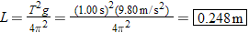
Example 10. Keeping Time
Determine the length of a simple pendulum that will swing back and forth in simple harmonic motion with a period of 1.00 s.

Slide 60
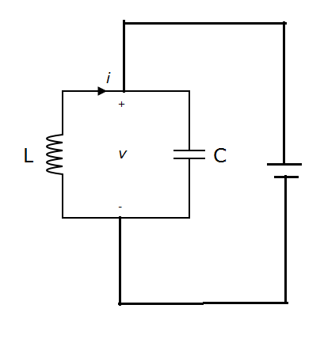
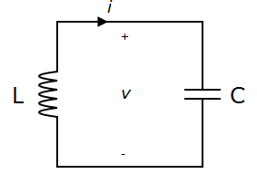
LC Circuit

Slide 61
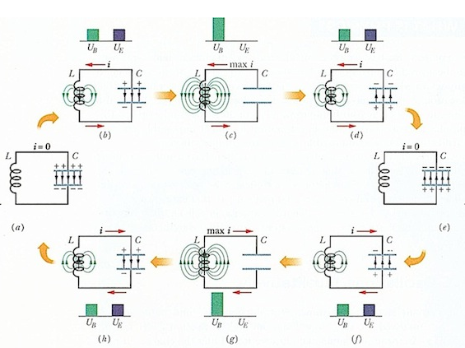
Charging discharging of an LC Circuit

Slide 62
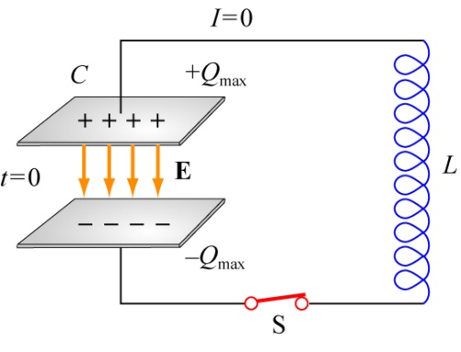
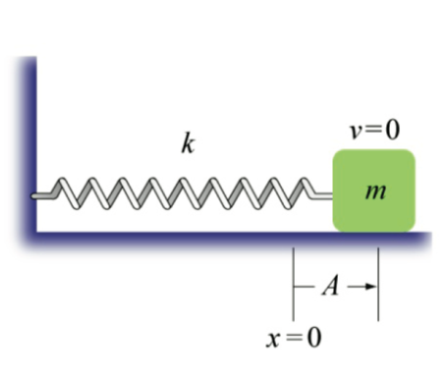
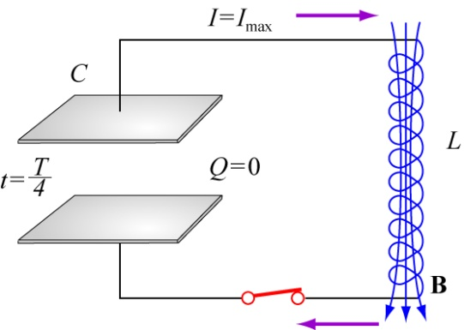
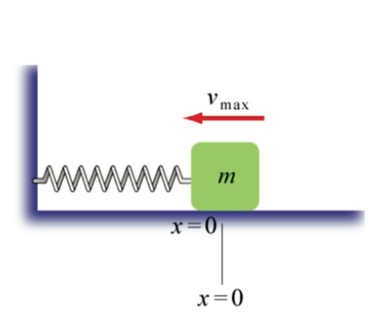
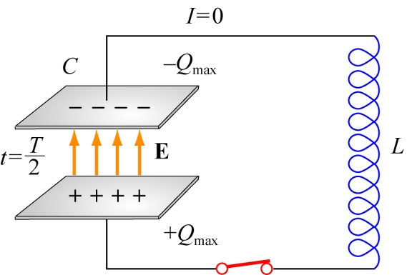
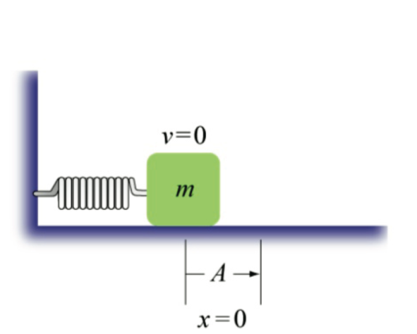
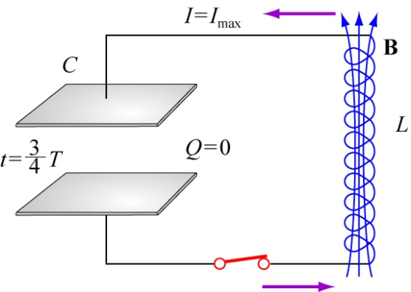
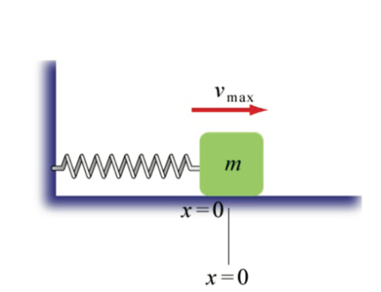
Energy stored in electric field
Energy stored in magnetic field
Energy stored in electric field
Energy stored in magnetic field

Slide 63
An LC circuit, also called a resonant circuit, tank circuit, or tuned circuit, consists of an inductor, represented by the letter L, and a capacitor, represented by the letter C. When connected together, they can act as an electrical resonator or oscillator.
Voltage across capacitor at any instant
Q is the charge on the capacitor and C is
capacitance of capacitor.

Slide 64
Voltage across inductor at the same instant
Kirchhoff's voltage law
Similar to differential equation of SHM

Slide 65
Time Period
Frequency

Slide 66
Solution of the differential equation is
Current in the circuit

Slide 67
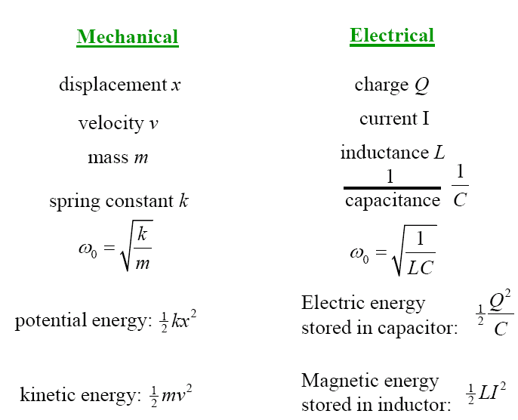

Slide 68
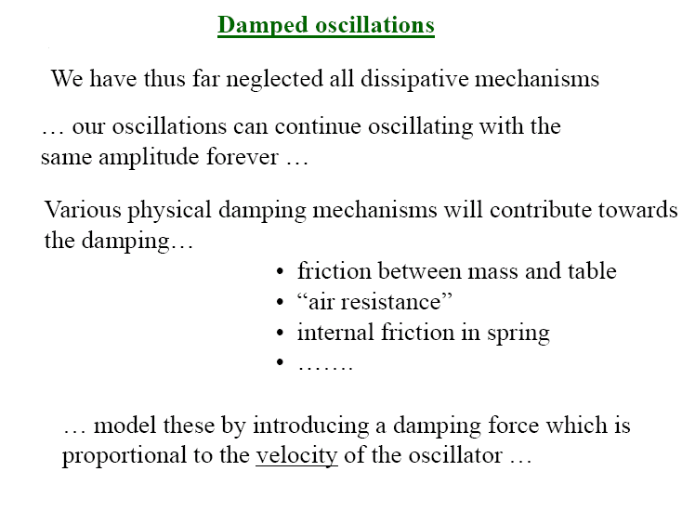

Slide 69
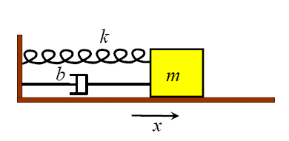
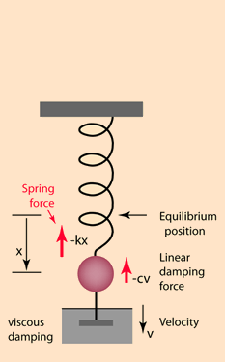
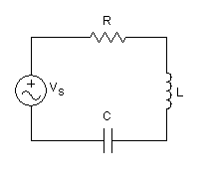
Examples some damped oscillating systems

Slide 70
Damped Harmonic motion: When oscillating
bodies do not move back and forth between
Precisely fixed limits because frictional force
dissipate the energy and amplitude of oscillation
Decreases with time and finally die out. Such
harmonic motion is called Damped Harmonic
Motion.

Slide 71
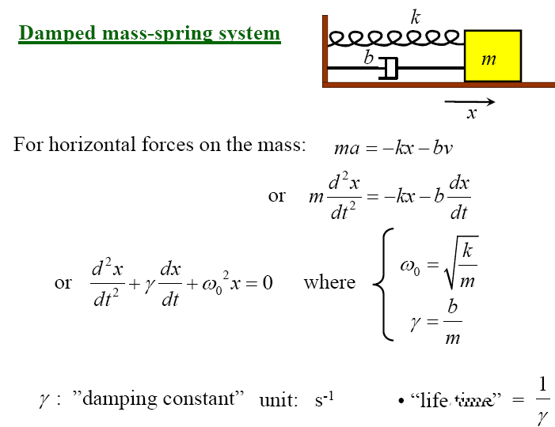
In theses systems the damping force

Slide 72
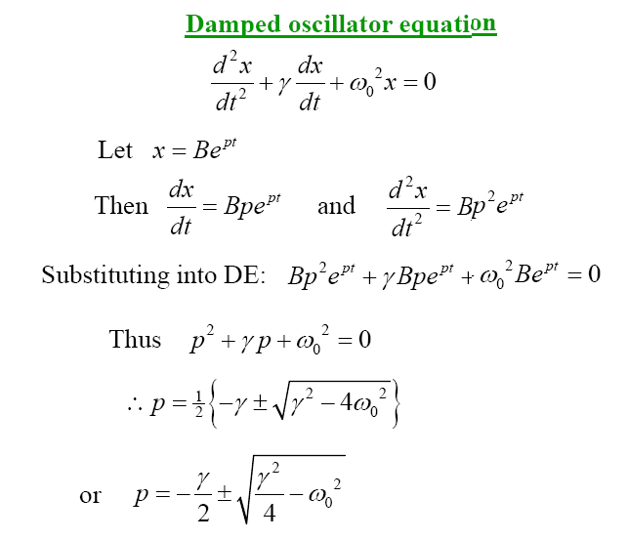
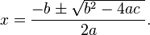

Slide 73
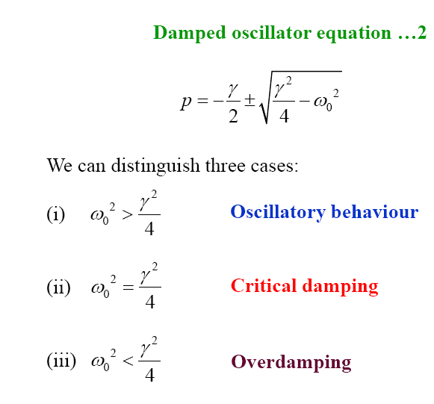

Slide 74
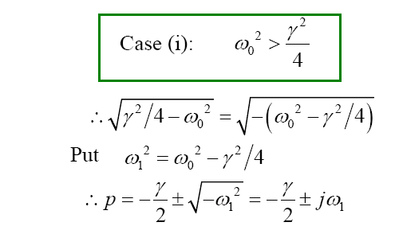
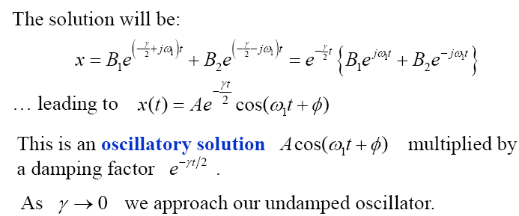

Slide 75
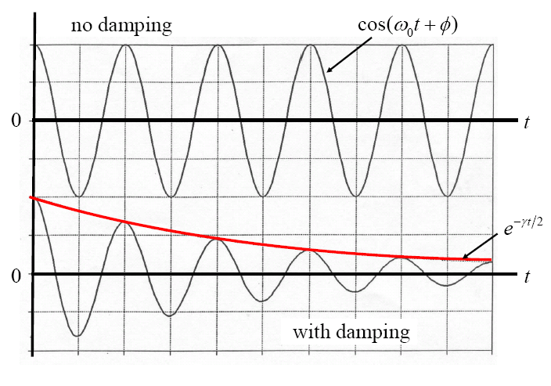

Slide 76


Slide 77


Slide 78


Slide 79


RLC circuit

Slide 80
Voltage across resistor R
Voltage across capacitor C
Voltage across inductor L
According to
Kirchhoff's voltage law

Slide 81
Rewrite the equation
Comparing with the equation
Where

Slide 82
Three distinguish cases are
Oscillatory behavior
i)
ii)
Critical damping
Over damping
iii)

Slide 83
Case i)
Solution of the differential equation
Where
Frequency of oscillation

Slide 84
EX. A capacitor 1.0µF, an inductor 0.2h and a resistance
800Ω are joined in series. Is the circuit oscillatory?
Find the frequency of oscillation.
Ex. Find whether the discharge of capacitor through the
following inductive circuit is oscillatory.
C = 0.1µF, L = 10mh, R 200 Ω
If Oscillatory, find the frequency of oscillation.

Slide 85


Slide 86


Slide 87


Slide 88


Slide 89
Lssajous’ Figures: When particle is
influenced simultaneously by two simple
harmonic motion at right angles to each
Other , the resultant motion of the particle
traces a curve. This curves are called
Lissajous’ figures. The shape of the curves
Depend on the time period, phase difference
and amplitude of the constituent vibrations.

Slide 90
Wave Motion
✦ Differential Equation of Wave motion
✦ Progressive and Standing Waves
✦ Group and Phase Velocity
✦ Power and Intensity of Wave Motion

Slide 91
Review: Simple Harmonic Motion
The position x of an object moving in simple harmonic motion as a function of time has the following form:
x = A cos (ωt+φ)
i.e. the object periodically moves back and forth between
the amplitudes x=+A and x=–A.
The time it takes for the object to make one full cycle is
the period T=2π/ω=1/f, where f is the frequency of the
motion.
Thus, the angular speed in terms of T and f reads
ω = 2π/T and ω = 2 π f

Slide 92
What is a wave ?
Nature of waves:
A wave is a traveling disturbance that transports energy from place to place.
There are two basic types of waves: transverse and longitudinal.
Transverse: the disturbance travels perpendicular to the direction of travel of the wave.
Longitudinal: the disturbance occurs parallel to the line of travel of the wave.

Slide 93


Slide 94
Examples:
Longitudinal: Sound waves (e.g. air moves back & forth)
Transverse: Light waves (electromagnetic waves, i.e. electric and magnetic disturbances)
The source of the wave, i.e. the disturbance, moves continuously in
simple harmonic motion, generating an entire wave, where each part of the wave also performs a simple harmonic motion.

Slide 95


Types of Waves
Transverse: The medium oscillates perpendicular to the direction the wave is moving.
Water waves
Longitudinal: The medium oscillates in the same direction as the wave is moving
Sound

Slide 96


Slide 97


Slide 98

Wave Properties...
Period: The time T for a point on the wave to undergo one complete oscillation.
Speed: The wave moves one wavelength λ in one period T so its speed is v = λ / T.

Slide 99
Wave Properties...
The speed of a wave is a constant that depends only on the medium, not on the amplitude, wavelength or period:
λ and T are related !
λ = v T or λ = 2π v / ω (since T = 2π / ω ) or λ = v / f (since T = 1/ f )
Recall f = cycles/sec or revolutions/sec
ω = 2πf
Is the speed of a wave particle the same as the speed of the wave ?
No. Wave particle performs simple harmonic motion: v=A ω sin ωt.

Slide 100
Wave Properties
Amplitude: The maximum displacement A of a point on the
wave.
Wavelength: The distance λ between identical points
on the wave.
Wavelength
Amplitude A
λ
A

Slide 101
Equation for a Progressive Wave
The simplest type of wave is the one in which
the particles of the medium are set into simple
harmonic vibrations as the wave passes
through it. The wave is then called a simple
harmonic wave.
P
O

Slide 102
Consider a particle O in the medium.
The displacement at any instant of time is given by
y = A sin ωt…….(1)
Where A is the amplitude, ω is the angular
frequency of the wave. Consider a particle P at
a distance x from the particle O on its right.
Let the wave travel with a velocity v from left
to right. Since it takes some time for the
disturbance to reach P, its displacement can be
written as

Slide 103

y = A sin (ωt-φ)………(2)
Where φ is the phase difference between the particles O and P.
We know that a path difference of λ corresponds
to a phase difference of 2π radians. Hence a
path difference of x corresponds to a phase
difference of

Slide 104

Displacement of particle P is

Slide 105


Slide 106
Similarly, for a particle at a distance x to the left of 0, the equation for the displacement is given by

Slide 107
Differential equation for wave motion
We have wave equation
Differentiating equation with respect to x,
We get,

Slide 108

The velocity of the particle whose displacement
y is represented by equation, is obtained by differentiating it with respect to t, since velocity is the rate of change of displacement with respect to time.

Slide 109
Comparing equations (2) and (3) we get,
Particle velocity = wave velocity x slope of the displacement curve or strain.
Differentiating equation (2)

Slide 110
Differentiating equation (3)
Comparing equs. (5) and (6)
Equation (7) represents the differential
equation of wave velocity

Slide 112
Ex. The equation of a traveling wave is
Find (i) wavelength, (ii) speed and
(iii) frequency of oscillating particle of the wave

Slide 113
Ex. When a simple harmonic wave is propagated through a medium, the displacement of a paricle in cm at any instant is
Calculate the amplitude, wave velocity, wavelength, frequency and period of the oscillating particle.

Slide 114
Ex. The equation of a traveling wave is
Find (i) amplitude (ii) wavelength (iii) speed (iv) frequency of wave

Slide 115
When a simple harmonic wave is propagated through a medium, the displacement of the particle at any instant of time is given by
calculate
(i)the amplitude of the vibrating particle,
(ii)wave velocity,
(ii)wave length,
(iv)frequency and
(v) time period.

Slide 116
Ex. A simple harmonic wave of amplitude 8units
travels a line of particles in the direction of
positive X axis. At any instant for a particle at a
distance of 10cm from the origin, the
displacement is +6units and at a distance a
particle from the origin is 25units, the
displacement is +4units. Calculate the
wavelength.

Slide 117


Slide 118


Slide 119


Slide 120


Slide 121


Slide 122


Slide 123
Forced Oscillations; Resonance
Forced vibrations occur when there is a periodic driving force. This force may or may not have the same period as the natural frequency of the system.
If the frequency is the same as the natural frequency, the amplitude can become quite large. This is called resonance.

Slide 124


Figure : Caption: (a) Large-amplitude oscillations of the Tacoma Narrows Bridge, due to gusty winds, led to its collapse (1940). (b) Collapse of a freeway in California, due to the 1989 earthquake.

Slide 125




Slide 126
Equation of Driven Harmonic Motion.
Consider what happens when we apply a time-dependent force F(t) to a system that normally would carry out SHM with an angular frequency ω₀.
Assume the external force F(t) = mF₀sin(ωt). The equation of motion can now be written as
The steady state motion of this system will be harmonic motion with an angular frequency equal to the angular frequency of the driving force.

Slide 127
Consider the general solution
The parameters in this solution must be chosen such that the equation of motion is satisfied. This requires that
This equation can be rewritten as

Slide 128
Our general solution must thus satisfy the following condition:
Since this equation must be satisfied at all time, we must require that the coefficients of cos(ωt) and sin(ωt) are 0. This requires that
and

Slide 129
The interesting solutions are solutions where A ≠ 0 and ω ≠ ω₀. In this case, our general solution can only satisfy the equation of motion if
and
The amplitude of the motion is thus equal to

Slide 130
If the driving force has a frequency close to the natural frequency of the system, the resulting amplitudes can be very large even for small driving amplitudes. The system is said to be in resonance.
In realistic systems, there will also be a damping force. Whether or not resonance behavior will be observed will depend on the strength of the damping term.

Slide 131


Slide 132

Driven Harmonic Motion.

Slide 133
Done for today! Thursday: Temperature and Heat!
Unusually Strong Cyclone Off the Brazilian Coast: A lot of Rotational Motion!
Credit: Jacques Descloitres, MODIS Land Rapid Response Team, GSFC, NASA

Slide 135

Forced Oscillations; Resonance
The sharpness of the resonant peak depends on the damping. If the damping is small (A) it can be quite sharp; if the damping is larger (B) it is less sharp.
Like damping, resonance can be wanted or unwanted. Musical instruments and TV/radio receivers depend on it.
Notes:
Figure 14-23. Caption: Resonance for lightly damped (A) and heavily damped (B) systems.

Slide 136




Forced Oscillations; Resonance
The equation of motion for a forced oscillator is:
The solution is:
where
and

Slide 137


Forced Oscillations; Resonance
The width of the resonant peak can be characterized by the Q factor:
Notes:
Figure 14-26. Caption: Amplitude of a forced harmonic oscillator as a function of ω. Curves A, B, and C correspond to light, heavy, and overdamped systems, respectively (Q = mω₀/b = 6, 2, 0.71).

